Slide 1
MGCR 222 - Introduction to Organizational Behaviour
Chapter 10-
Leading Groups and Teams
Maya Sharma

Slide 2
Learning Objectives
Identify the characteristics of and differences between groups and teams;
Identify the benefits of team work
Identify Tuckman’s Five Stages of Team Development
Identify the characteristics of effective teams and the 4 types of teams.
Understand common roles in teams.
Understand the challenges in managing/working in teams

Slide 3
Benefits of Teams In the Workplace?
Productivity & efficiency
Cross pollination of knowledge & skills
Supports collaboration (not competition)
Flatter organizational structures
Diversity of thoughts, perspectives, etc.
Emotional & Psychological intimacy
Support & Distribution of workload
Organizational benefits
Individual benefits

Slide 4
Teams vs. Groups: What’s the Difference?
Groups
  Two or more people who share a common interest or association
Teams
  A task/goal oriented collection of people who work interdependently as a unit to achieve common objective and are mutually accountable.

Slide 5

Four Types of Teams
Permanent Teams & Project Teams
Hierarchical Teams & Self Managed Teams
Functional & Cross Functional
On-Site Teams & Virtual Teams
Team Identity

Slide 6
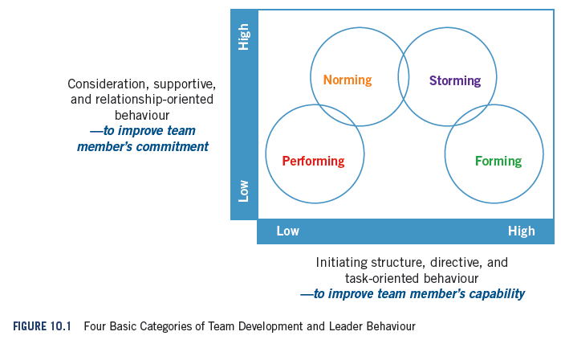
Notes:
LO1

Slide 7
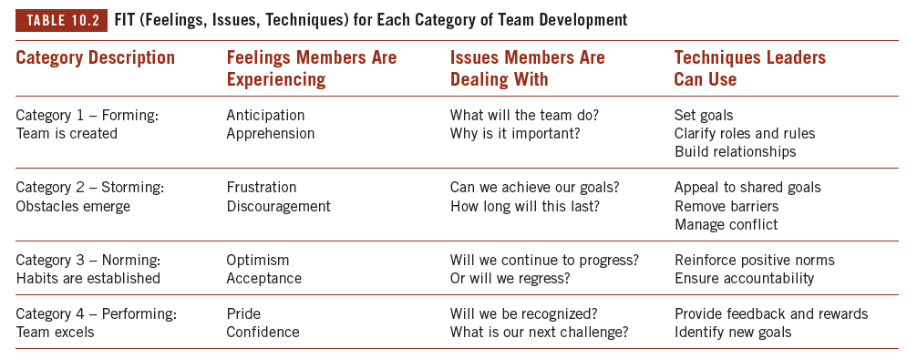
Read On Your Own

Slide 8
Roles: Task Functions
Team Task Functions: Activities directly related to the effective completion of the team’s work
Initiate
Activities
Summarize
Ideas
Coordinate
Activities
Test
Ideas
Team
Tasks
Evaluate
Effectiveness
Elaborate
Concepts
Diagnose
Problems
Seek
Information
Give
Information
Notes:
Task oriented roles:
- These are the roles that relate to getting the work done
. They represent the different roles needed to take a project step-by-step from initial conception through to action. EX: Information Seeker. Determines what information is missing and needs to be found before moving forward. Information Giver – Provides factual information to the group.

Slide 9
Roles: Maintenance Functions
Maintenance Functions: Activities essential to the effective, satisfying interpersonal relationships within a team or group
Support
Others
Express
Member Feelings
Test Group
Decisions
Harmonize
Conflicts
Maintenance
Tasks
Gatekeep
Communication
Test
Consensus
Reduce
Tension
Set
Standards
Follow
Others’ Lead
Notes:
Maintenance Functions: nurture the relationships in the group: enhance cohesiveness, cooperation, team work

Slide 10
Roles: Individualistic
Individual (oriented) roles
  Roles performed by team members that are not conducive to achieving team goals and tasks.
  Ex: Dominator, Blocker, Recognition seeker
Notes:
Individualistic roles: These roles disrupt group progress and weaken its cohesion.

Slide 11
What Makes Teams Effective?
Size-
Keep it small
Cohesiveness- Presence of commitment & attachment
Tasks- Interdependence & cohesion
Team Effectiveness
Roles-
Reduce stress through role clarity, avoiding role conflict, balancing work load
Strong Norms- Workload, Info. Sharing, Interactions, conduct
Diversity-
Must be managed

Slide 12
Sources Of Team Conflict & Their Cures
Scarce resources
  Increase or rearrange resources, boundary spanning
Task Interdependence
  Redesign structures
Conflicting Goals
  Superordinate Goals
Personal Conflicts
  Provide support to work through issues

Slide 13
Tackling Free Riding (Social Loafers)
Conventional approach: limit the negative effects through monitoring and accountability
monitoring team members’ contributions
Keep teams lean
Establish accountability
Introduce team-level rewards
Select “team players” for teamwork (agreeableness, conscientiousness, etc.)
Training to overcome the emotional responses of the “sucker effect”

Slide 14
Sustainable Approach to Tackling Free Riders
Recognize, reinforce and reward consistent contributors.
  Free riders
  Conditional contributors
  Consistent contributors

Slide 15

Social Cohesiveness
Social Cohesiveness :
  Helps to grease the wheels
  Built over time through team dynamics, nurturing relationships and trust
  Size has an impact
  Too much can lead to groupthink

Slide 16
Dialectical Inquiry and Groupthink
(read on your own)
Causes of Groupthink:
Overblown social cohesion, overconfidence, pressure to conform, the good outweighs the bad aspects of an issue, isolation from outsiders, stressful environment, desire to avoid conflict, controlling/dominant leaders.
Dialectical Inquiry can combat groupthink

Slide 17
Key Terms
Brainstorming
is an unstructured process of sharing ideas.
Consistent contributor
is someone who contributes regardless of how little his or her teammates contribute.
Delphi technique
is a technique in which questions are posed to team members remotely and responses are returned to the leader; the leader then compiles the ideas without attaching names to them and sends the list back to team members for further consideration and response.
Dialectical inquiry
is a staged debate between two dominant perspectives.
Free riding
is doing less than your best or contributing less than your fair share to reach the team’s goal.
Group
is a collection of two or more people who share a common interest or association.
Groupthink
is the tendency of group members to strive for and maintain consensus on a decision rather than disrupt the group.
Nominal group technique
is an information-sharing technique in which the leader asks participants to silently and individually write down all their ideas related to a specific question.
Norms
are shared beliefs about social and task behaviours in a group.
Social cohesion
is the attachment and attraction of team members to one another.

Slide 18
Key Terms
Superordinate goal
is a higher-level goal recognized as important by team members.
Task cohesion
is the shared commitment among members to achieving a goal.
Team
is a task-oriented collection of people who work interdependently as a unit to achieve common goals and are accountable to one another to achieve those goals.
Team conflict
is a real or perceived difference in interests between two or more teams members
Team diversity
is the extent to which member characteristics differ within the team.
Team identity
is the collective sense of identification and loyalty team members feel towards the team.
Team task interdependence
refers to the extent team members require resources or support from other team members to complete their tasks.

Slide 19
Next Class
Next class Midterm revision

